Slide 1
INSPECTION
THROUGH INNOVATION & TECHNOLOGY
An ISO 9001:2015 Certified Company

Slide 2
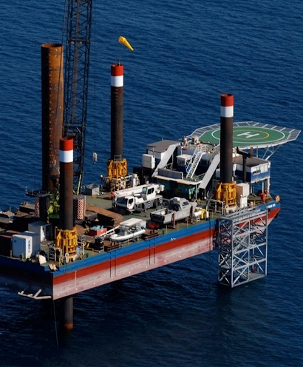
INTRODUCTION
is an ISO 9001:2015 Certified Company established in 2005, primarily, as an “Advanced Non Destructive Testing (ANDT) center” to provide Inspection Services to the Oil, Gas, Power, Marine, Offshore, Wind Energy and Nuclear Sector.
We are pioneers in the field of Advanced Ultrasonic Testing having successfully implemented the AUT technique (PAUT & TOFD) in a number of projects, worldwide, both Onshore & Offshore. Additionally, we provide other Advanced NDT services such as Pulsed Eddy Current (PEC), AUT(Pipe Wizard), Long Range UT (LRUT), Helium Leak Testing, ACFM, Boroscopy, Tubing Inspection (IRIS/ECT/RFET/MFL), Corrosion Mapping, Storage Tank Inspection (MFL,RMS) etc.
In addition to the above, we provide Project Support Services (PSS) and supply specialized technical personnel directly to the client for their projects. We have a vast pool of professionals who are highly experienced and certified in various disciplines including Engineering, Construction, QA/QC and Commissioning.
In a span of 13 years, we have provided services to major clients like Shell, GE, Saudi Aramco, Saipem, ONGC, Qatar Petroleum, PDO Oman, Aker Solutions, Reliance Industries Ltd, Worley Parson, Foster Wheeler, Alstom, RINA, OCP Morocco, SapuraKencana for many of their premier projects in South Asia, Middle East ,Far East and Africa.
All the activities and services are carried out using sophisticated equipments combined with latest technology available, globally, backed by a team of qualified and experienced professionals with specific focus and attention to Quality and work safety

Slide 3
NDT SERVICES
ADVANCED UT SERVICES
TUBING INSPECTION
OTHER ADVANCED NDT SERVICES
Time of Flight Diffraction (TOFD)
Phased Array Ultrasonic Testing (PAUT)
Corrosion Mapping Services (CMS)
LRUT – Long Range UT (Guided Wave)
Short Range Ultrasonic Testing (SRUT)
High Temperature UT
High Temperature PAUT
Auto UT (Pipe Wizard)
Eddy Current Testing (ECT)
Remote Field Electromagnetic Testing (RFET)
Magnetic Flux Leakage (MFL)
Internal Rotating Inspection Service (IRIS)
Pulse Eddy Current(PEC)- CUI
Magnetic Flux Leakage (MFL -Tank & Pipe)
Acoustic Emission Testing (AE)
Helium Leak Testing
Boroscopy
Flare Tip Inspection Services ( UAV Flare)
CP Survey of Offshore Platforms
Alternating Current Field Measurement (ACFM)
Digitization Of Radiographic Films
Tank Settlement Survey
Thermography
IRATA Rope Access Services
Positive Material Identification (PMI)
Underwater NDT
In-situ Metallography

Slide 4
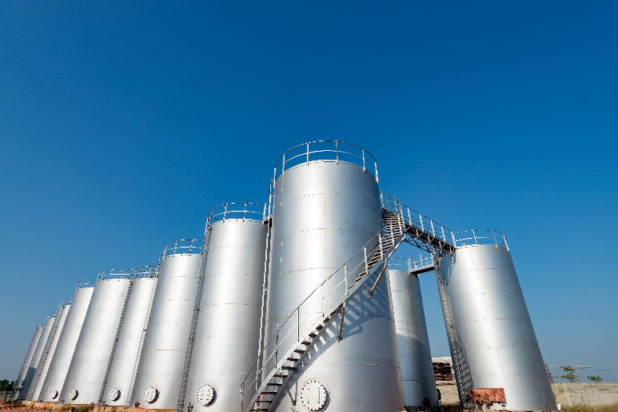
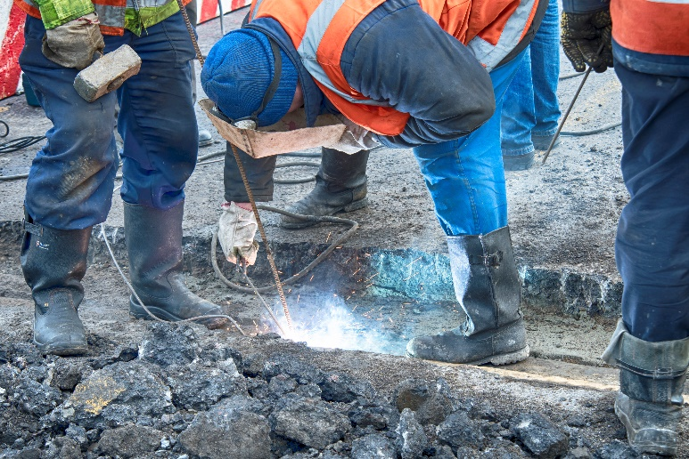
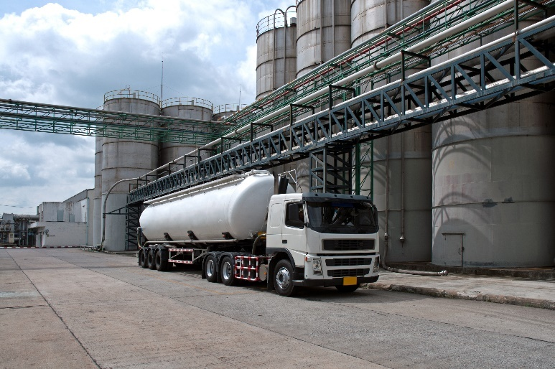

SERVICES – PROJECT SUPPORT SERVICES
We provide the following category of specialized technical Personnel directly to the client for shutdowns, New construction and
In-Service projects.
Construction manager (Mechanical/Civil/Electrical)
QA QC Managers/Engineers/Inspectors/Supervisor
Project Engineers
Welding Engineers & Inspectors (AWS/CSWIP)
PCN and ASNT level III’s
NDT Technicians (PCN, ASNT and ISO Certified)
Coating Inspectors (BGas & NACE)
Tubing Inspectors (ECT, RFET, IRIS,MFL)
API Inspectors (510/570/653)
IRATA Certified Rope Access Level I, II and III
Tank Floor Inspectors (MFL)
Shutdown Inspectors (All Categories)
Offshore QA QC Inspectors

Slide 5
SERVICES – ASSET INTEGRITY MANAGEMENT
RELIABILITY CENTERED MAINTENANCE (RCM)
RISK BASED INSPECTION
(RBI)
PIPE LINE INTEGRITY MANAGEMENT (PIMS)
CORROSION MANAGEMENT SYSTEM
(CMS)
FITNESS FOR SERVICE
(FFS)

Slide 6

SERVICES – TRAINING COURSES
ASNT Level II RT, MT, PT & UT, PAUT & TOFD (American Society for Non-Destructive Testing)
PCN Level II MT, PT, UT, RT, TOFD & PAUT (Personnel Certification for Non-Destructive Testing)
ISO 9712 MT, PT, UT, RT, ET
CSWIP 3.1, 3.2, 3.9, AWS, BGAS Certification Courses
Instrumentation and Control Training Courses

Slide 7
EQUIPMENT RESOURCES
Sr.No. | Equipment | Manufacturer | Qty
1 | PAUT/TOFD Omniscan MX / MX 2 | Olympus/Zetec Topaz | 12
2 | Hydroform Corrosion Mapping | Olympus | 2
3 | Corrosion Mapping System | AUT Solutions | 1
4 | Corrosion Mapping System | Wes dyne CMAPPS | 5
5 | RMS2 Corrosion Mapping | Silver wing | 2
6 | Long Range UT (LRUT) | GUL/Ultra Wave | 4
7 | Pulse Eddy Current – PEC-CUI | Eddyfi | 3
8 | MFL Tank Floor Inspection | Silver wings | 3
9 | MS5800 - Tubing Inspection equipment | Olympus | 8
10 | Helium Leak Testing | Adixen ASM | 2
11 | Videoscopy/Boroscopy | GE/ Olympus | 3
12 | Cobra Scanner | Olympus | 2
13 | AUTO UT machine ( Pipe Wizard) | Olympus | 2
14 | PMI ( Positive Material Identification) | Olympus/Niton | 2
15 | MUT ( Manual Ultrasonic Testing ) | Olympus/GE/Sonatest | 10
16 | RT Film Digitizer | Kodak | 2

Slide 8
MANPOWER RESOURCES
Sr.No. | Manpower Resources | Number
1 | PCN Level 3 (PAUT , TOFD, UT, MT, PT, RT) | 7
2 | PCN Level 2 (PAUT , TOFD, UT, MT, PT, RT) | 30
3 | ASNT Level III (UT, PT, MT, RT) | 15
4 | ASNT Level II - PAUT and TOFD technicians | 20
5 | Tubing Inspectors - MS5800 ECT, RFET, IRIS and MFL | 25
6 | Multi Skilled Conventional NDT Technicians | 100
7 | Welding Inspectors (CSWIP and AWS) | 20
8 | Plant Inspectors (API Certified) | 10
9 | Coating Inspectors (NACE & BGas) | 20
10 | IRATA Approved Rope Access Technicians - Level I, II, III | 15
11 | Guided Wave operators (LRUT) | 6
12 | Pulse Eddy Current operators (PEC) | 4
13 | Offshore QA/QC & NDT Inspectors with BOSIET | 25
14 | Multi Skilled Advance NDT Inspectors | 25

Slide 9
SOME MAJOR ADVANCED NDT PROJECTS DONE IN THE PAST
Sr.No | Period | Client | Location | Description
1 | Jan 05 – May 07 | Trafigura Construction, Ghana | Ghana, West Africa | 3rd party inspection on behalf of Moody International during pipeline construction (18" & 36“) connecting the Offshore sub sea pipelines to the onshore refinery including pigging & Hydro testing
2 | May 06 – June 06 | Nagarjuna Fertilizers | Kakinada(M), India | Phased Array Inspection of Plant equipment & piping
3 | Sep 07 – Aug 08 | Tekfen/ Foster Wheeler | PetroRabigh Refinery, Saudi Arabia | TOFD inspection of plant piping, pipe dia’s ranging from 4 to 48 inches of various thickness ranging from 7.8 to 40 mm
4 | Aug 08 – Dec 09 | Saipem (Saudi Aramco Project) | KCC & KUC, Khurais, Saudi Arabia | TOFD & Phased array inspection of Pipe to fittings (Flanges, reducers, Elbows etc) of various dia ranges
5 | Oct 08 – Nov 08 | Saipem (Saudi Aramco Project) | UBTG-4, Saudi Arabia | AUT of 156 Kms cross-country pipeline, 56 inch dia
6 | Dec 09 – Jan 10 | Star SAIPEM TAQA AL-RUSHID (Saudi Aramco Project) | Safaniya Project, Saudi Offshore | TOFD inspection of crown Rim Line weld point of 40" Offshore-Onshore Tie-in joints
7 | Oct 09 – Dec 09 | Aker Solutions | Kelang, Malaysia | Phased array inspection of Pipe risers
8 | Oct 10 – Sep 11 | Zamil Steel (Saudi Aramco Project) | Dammam, Saudi Arabia | TOFD & Phased array inspection of Longitudinal & Circumferential weld seams and Nozzles of various Pressure Vessels
9 | Dec 11 – Mar 13 | Qatar Petroleum | Qatar Offshore | Corrosion Mapping & TOFD Inspection (In service Inspection) of pressure vessels and equipments (RMS2 and Hydroform Corrosion Mapping)
10 | Aug 12 – Aug 12 | Worley Parson | Hong Kong | Phased Array Ultrasonic Testing of Plant Piping

Slide 10
SOME MAJOR ADVANCED NDT PROJECTS DONE IN THE PAST
Sr.No | Period | Client | Location | Description
11 | Mar 13 – Apr 13 | ORYX | Qatar Shutdown job | Supply of 40 No's of NDT Technicians for Shutdown job
12 | May 13 – Dec 13 | Zamil (Saudi Aramco Project) | Saudi Arabia | TOFD & Phased array inspection of Longitudinal & Circumferential weld seams and Nozzles of various Pressure Vessels
13 | Nov 13 – Nov 13 | Daleel Petroleum | Oman | Pipeline In-service Inspection of 16" pipeline at Bushra, Oman
14 | Nov 13 – Dec 13 | Qatar Petroleum | Qatar | Sub Sea Corrosion Mapping (P-Scan) using RMS2 and Hydroform Corrosion Mapping
15 | Jan 14 – Jan 14 | Applus Velosi | Oman | X-mas Tree inspection to verify for clad bonding
16 | Feb 14 – Feb 14 | Applus Velosi | Oman | MFL Scanning of 19 m Storage Tank
17 | Mar 14 – Apr 14 | Applus Velosi | Ras Gas, Qatar | Supply of 60 No's Multi Skilled NDT technicians for Shutdown job
18 | Apr 14 – May 14 | Applus Velosi | Ras Gas, Qatar | Supply of 5 No's of Tubing Inspector who have experience in MS5800 Olympus (ECT, RFET, IRIS)
19 | Jun 14 – July 14 | Dynaquest Energy Limited | Nigeria, Port Harcourt | Corrosion Mapping on 8’’ Imo R1 to Imo R CS & 6” Imo R1 to Imo R1 Tie in MF At Imo Rivers Nigeria for Shell Corporation
20 | Nov 14 – Dec 14 | Equate Company | Kuwait | PAUT, Tubing Inspection & Boroscopy Services

Slide 11
SOME MAJOR ADVANCED NDT PROJECTS DONE IN THE PAST
Sr.No | Period | Client | Location | Description
21 | Jun 14 – May 15 | Sapurakencana/British Gas | Mumbai Offshore | Supply of 30 Nos QA/QC Inspectors for MB Pipeline and Platform project (Subsea Pipeline and Well Platform Installation)
22 | Jan 15 – Feb 15 | Velosi /R-LOC & Q-Chem | Qatar | Supply of 16 Tubing Inspectors for Shutdown job
23 | Aug 15 – Aug 15 | Aker Solutions | Kakinada(M), India | Hydroform Corrosion mapping of Pipe Spools
24 | Oct 15 – Oct 15 | Spectro group | Ghanderbal, Jammu & Kashmir | Hydroform Corrosion mapping of Penstock Pipeline for Hydro Power Station
25 | Oct 15 – Dec 15 | RINA India Ltd/ ONGC | Mumbai Offshore | Supply of 26 QA/QC Coating & Welding Inspectors
26 | Oct 15 – Nov 15 | RINA India Ltd / Cochin Shipyard | Cochin | Supply of 30 QA/QC Coating & Welding Inspectors
27 | Nov 15 – Nov 15 | Applus Velosi | Qatar-GDI Rig Shutdown | ACFM Services Provided (Equipment and Technician)
28 | Nov 15 – Dec 15 | Applus Velosi | Oman | PAUT on Stainless steel Piping ( Dia Ranging from 6" to 24" )
29 | Dec 15 – Jan 16 | PITTI Engineering | Hyderabad | Supply of 15 No's NDT Inspectors for Barrel Casting inspection
30 | Jan 16 – Jan 16 | Alstom | Baroda | AUT for Turbine Rotor Inspection

Slide 12
SOME MAJOR ADVANCED NDT PROJECTS DONE IN THE PAST
Sr.No | Period | Client | Location | Description
31 | Jan 16 – Mar 16 | RINA India Ltd / ONGC | Mumbai Offshore | Supply of 30 No's NDT Inspectors
32 | Feb 16 – Mar 16 | AMOSCO | Nigeria | PAUT on Riser Bolt of 15" length and 3.5" Dia
33 | Mar 16 – Apr 16 | Applus Velosi / PDO | Oman | Supply of 15 AUT Technicians for Pipeline Inspection
34 | Apr 16 – Apr 16 | Applus Velosi / Oxy | Oman | Supply of 12 No's IRATA Rope Access UT Inspectors
35 | Apr 16 - May 16 | SGS/Exxon Mobil | Angola | PAUT & C-Scan Corrosion Mapping of Pressure Vessels & Nozzles
36 | Jun 16 – Jun 16 | Alstom | Baroda | AUT for Turbine Rotor Inspection
37 | Aug 16 – Aug 16 | British Gas | Mumbai Offshore | Hydroform Corrosion Mapping Services of Vessels & Piping
38 | Sep 16 – Sep 16 | Alstom | Baroda | AUT for Turbine Rotor Inspection
39 | Dec 16 – Jan 17 | Vestas | Gujrat, India | AUT of Wind Turbine blade
40 | Jan 17 – Feb 17 | S2G, Morocco | Niger | Supply of 30 AUT Technicians for Power Plant piping Inspection

Slide 13
SOME MAJOR ADVANCED NDT PROJECTS DONE IN THE PAST
Sr.No | Period | Client | Location | Description
41 | Jan 17 – Jan 17 | Shell India | Mumbai offshore | Cathodic Protection Survey of Offshore platforms
42 | Feb 17 – Mar 17 | Applus Velosi / RasGas | Qatar | Supply of 30 Tubing Inspectors along with MS5800 (ECT, RFET and IRIS)
43 | Feb 17 – Feb 17 | Qatar Petroleum | Qatar | Supply of 15 AUT Technicians for Pipeline Inspection
44 | Mar 17 – Mar 17 | Spectro Analytical Labs | India | PAUT Services
45 | Apr 17 – Apr 17 | Applus Velosi /RasGas | Qatar | Supply of 15 Tubing Inspectors along with MS5800 (ECT, RFET and IRIS)
46 | Apr 17 – Apr 17 | Reliance Industries Ltd | Kakinada(M), India | Hydro form Corrosion Mapping of Pressure Vessels
47 | Jan 17 – Jun 17 | ISGEC/ PDO | Yamuna Nagar | PAUT Inspection of Pressure Vessels including Nozzle Joints
48 | Apr 17 – May 17 | Applus Velosi | Qatar | Supply of 30 Tubing Inspectors for Ras Gas Shutdown Job
49 | Apr 17 – May 17 | Applus Velosi | Qatar | Supply of 20 AUT Technicians for Total Offshore Job
50 | May 17 – May 17 | Velosi Applus | Oman | Supply of UT Calibration Blocks

Slide 14
SOME MAJOR ADVANCED NDT PROJECTS DONE IN THE PAST
Sr.No | Period | Client | Location | Description
51 | May 17 – May 17 | Applus Velosi | Qatar | Supply of 10 PAUT Inspectors for Offshore job
52 | Aug 17 – Sep 17 | Dynaquest Energy Limited Nigeria | Nigeria | PAUT of Storage Tanks
53 | Aug 17 – Aug 17 | Applus Velosi | Oman | Helium Leak Testing
54 | Aug 17 – Sep 17 | OCA Egypt S.A.E. | Egypt | PAUT Services Of Power Plant piping
55 | Oct 17 – Oct 17 | Vestas Wind Technology India Pvt Ltd | Chennai | PAUT Inspection of Wind Turbine Blade
56 | Nov 17 – Nov 17 | TCR Advanced Engineering Pvt Ltd | Gujarat | PAUT Services
57 | Dec 17 – Jan 17 | Vestas Wind Technology India Pvt Ltd | Chennai | PAUT Services Of Wind Turbine Blade
58 | Jan 18 – Feb 18 | PDO / HI- tech Inspection Services L.L.C | Oman | PAUT Services
59 | Feb 18 – Mar 18 | Sievert International Inspection Co.WLL | Qatar | Hydro form corrosion mapping (Shutdown Services)
60 | Mar 18 – Apr 18 | Furnace Fabrica | Morocco | Supply of Multi-skilled NDT technicians

Slide 15
SOME MAJOR ADVANCED NDT PROJECTS DONE IN THE PAST
Sr.No | Period | Client | Location | Description
61 | Mar 18 – Mar 18 | NDT international India PVT LTD | Chennai | PAUT Services
62 | Mar 18 - Apr 18 | Aries Marine Co. WLL | Qatar | Supply of 10 NDT Inspectors
63 | Mar 18 - Mar 18 | Qatar Petroleum /Applus Velosi | Qatar | Supply 4 of Tubing Inspectors (IRIS,ECT)
64 | Mar 18 – May 18 | ONGC | Mumbai Off-shore | MUT Inspection of Offshore structures
65 | Apr 18 - May 18 | ONGC/LTHE | Mumbai Off-Shore | PAUT Services of Offshore Structures & Spools
66 | Apr 18 – May 18 | AMOSCO | Nigeria | PAUT Services
67 | May 18 – July 18 | IRSA Technical Inspection & Corrosion control co. | UAE | PEC & LRUT Services
68 | Jun 18 – Jul 18 | Barka Power Plant/Hitech Inspection | Oman | PAUT of Power Plant Piping & Boiler Tube welds using Cobra scanner
69 | July 18 – Jul 18 | GE Power India | Maithoon Power Limited, Jharkhand | PAUT of Boiler Tube welds Using cobra scanner
70 | Aug 18 – May 19 | OCP / Jacobs , Morocco | Morocco | PAUT of Small bore piping Using Cobra scanner

Slide 16
SOME MAJOR ADVANCED NDT PROJECTS DONE IN THE PAST
Sr.No | Period | Client | Location | Description
71 | Nov 18 – Nov 18 | S2G Test Industrial, Morocco | Morocco | In-Suit Metallography
72 | Nov 18-Till Date | GE Power India Ltd | NTPC Barh , India | PAUT Inspection of Boiler Tubes
73 | Nov 18 – Mar 19 | ONGC / L&T offshore/OTI | Mumbai Offshore | PAUT 7 MUT/MPI of offshore Jackets and Riser Spools.
74 | Jan 19 – Jan 19 | TCR advanced Engineering | Mumbai | Hydro form corrosion mapping services
75 | Mar 19 – Mar 19 | S2G Test Industrial, Morocco | Morocco | NDT training for technicians
76 | Mar19 – Mar 19 | GE Power India Ltd | CPP Lalkuam | PAUT of Boiler Tubes at paper mill
77 | May19- Till Date | Reliance / Sapura/ OTI | Jamnagar, India | MUT & MPI Inspection onboard S2000(offshore)
78 | Jun 19 – Till Date | Ayoki Fabricon | Rwanda | PAUT of Boiler Tubes welds & associated piping.

Slide 17
PULSE EDDY CURRENT EXPERIENCE (CUI)
Sr.No | Period | Client | Location | Description
1 | Sep 17 Onwards | Petroleum Development of Oman | SaihNiyadha, Oman | SaihNiyadha Gas plant
2 |  | Petroleum Development of Oman | Barik, Oman | Barik Gas Plant
3 |  | Petroleum Development of Oman | Amal,Oman | Amal Steam Plant
4 |  | Petroleum Development of Oman | SaihRawal, Oman | Central Processing Plant
5 |  | Petroleum Development of Oman | Qarnalam, Oman | Qarnalam Steam plant
6 |  | Petroleum Development of Oman | SaihRawal, Oman | Integrated Power Station
7 |  | Oman Refinery petrochemical company | Sohar , Oman | All Insulated Lines
8 | Apr 18 | IRSA Technical Inspection & Corrosion Control | UAE | PEC of Boiler

Slide 18
LRUT PREVIOUS PROJECT EXPERIENCE
Sr.No | Period | Client | Location | Description
1 | Jun 13 | Petroleum Development Of Oman | Sayyala | LRUT Inspection of 16” and 28” Flare Lines
2 | Jun 13 | Petroleum Development Oman LLC | Mina Al Fahal | Long Range Ultrasonic Inspection on 30” 600#A0107RS Bypass to PRS Pipe Line
3 | Aug 13 | Petroleum Development Of Oman | Mina Al Fahal, Muscat | LRUT Inspection of 30” and 40” Loading Lines Mina Al Fahal, Muskat
4 | Aug 13 | Petroleum Development Oman LLC | Lekhwair | Long Range Ultrasonic Inspection On 8” Oil line from Lekhwair E- RMS- 7
5 | Feb 14 | Petroleum Development Oman LLC | Lekhwair station | Long Range Ultra sonic Inspection On 12” Associated pipe at RMS4Bulk HDR to LPS Line
6 | Mar 14 | Petroleum Development Oman LLC | NIMR Station | Long Range Ultrasonic Inspection On Various Lines crossing bund wall of T 4813
7 | May 14 | Petroleum Development Oman LLC | Rima Station | Long Range Ultrasonic Inspection On Various Lines crossing bund wall of T 4007
8 | May 14 | Petroleum Development Oman LLC | MMPS | LRUT INSPECTION ON LOCATION PASSING BUND WALL IN MMPS
9 | Aug 15 | Petroleum Development Oman LLC | Amal Steam Plant | Long Range Ultrasonic Inspection on Amal Steam Plant
10 | Sep 15 | Petroleum Development Of Oman | AL Noor station | LRUT INSPECTION ON ELEVEN TAGS @ AL NOOR STATION

Slide 19
LRUT PREVIOUS PROJECT EXPERIENCE
Sr.No | Period | Client | Location | Description
11 | Sep 15 | Petroleum Development Oman LLC | NRPS | Long Range Ultrasonic Inspection On 6” MGL – NRPS OM.SOG.00570
12 | Dec 15 | Petroleum Development Oman LLC | LEKHWAIR | Long Range Ultrasonic Inspection On 6” L-547
13 | Jan 16 | Petroleum Development Oman LLC | Fahud | Long Range Ultrasonic Inspection On 3” FHD.F087GL
14 | Mar 16 | Petroleum Development Oman LLC | Fahud | Long Range Ultrasonic Inspection On 6” FHE.F087OP
15 | Aug 16 | Petroleum Development Oman LLC | Fahud | Long Range Ultrasonic Inspection On 16” FHD.053750B
16 | Aug 16 | Petroleum Development Oman LLC | Marmul | Long Range Ultrasonic Inspection on 30" MPS.24052P
17 | Oct 16 | Petroleum Development Oman LLC | FAHUD/QarnAlam | Long Range Ultrasonic Inspection on Pipelines various Dia on NPP Pipeline Tags
18 | May 17 | PDO /Alghalbi | North Oman | Long Range Ultrasonic Inspection on 8"Haniya RMS to AL huwaishah
19 | Dec 17 | PDO /Amal Petroleum | South Oman | Long Range Ultrasonic Inspection on NON Piggable Lines on various assets at PDO
20 | Feb 18 | Petroleum Development Oman LLC | South Oman | Long Range Ultrasonic Inspection on Hazar Zauliyah Pipeline approximately 30 km
21 | Mar 18 | Salalah Methanol Compnay | Salalah | Long Range Ultrasonic Inspection contract for Salalah Methanol company
22 | May 18 | IRSA Technical Inspection & Corrosion Control | Iran | LRUT Equipment With technician

Slide 20
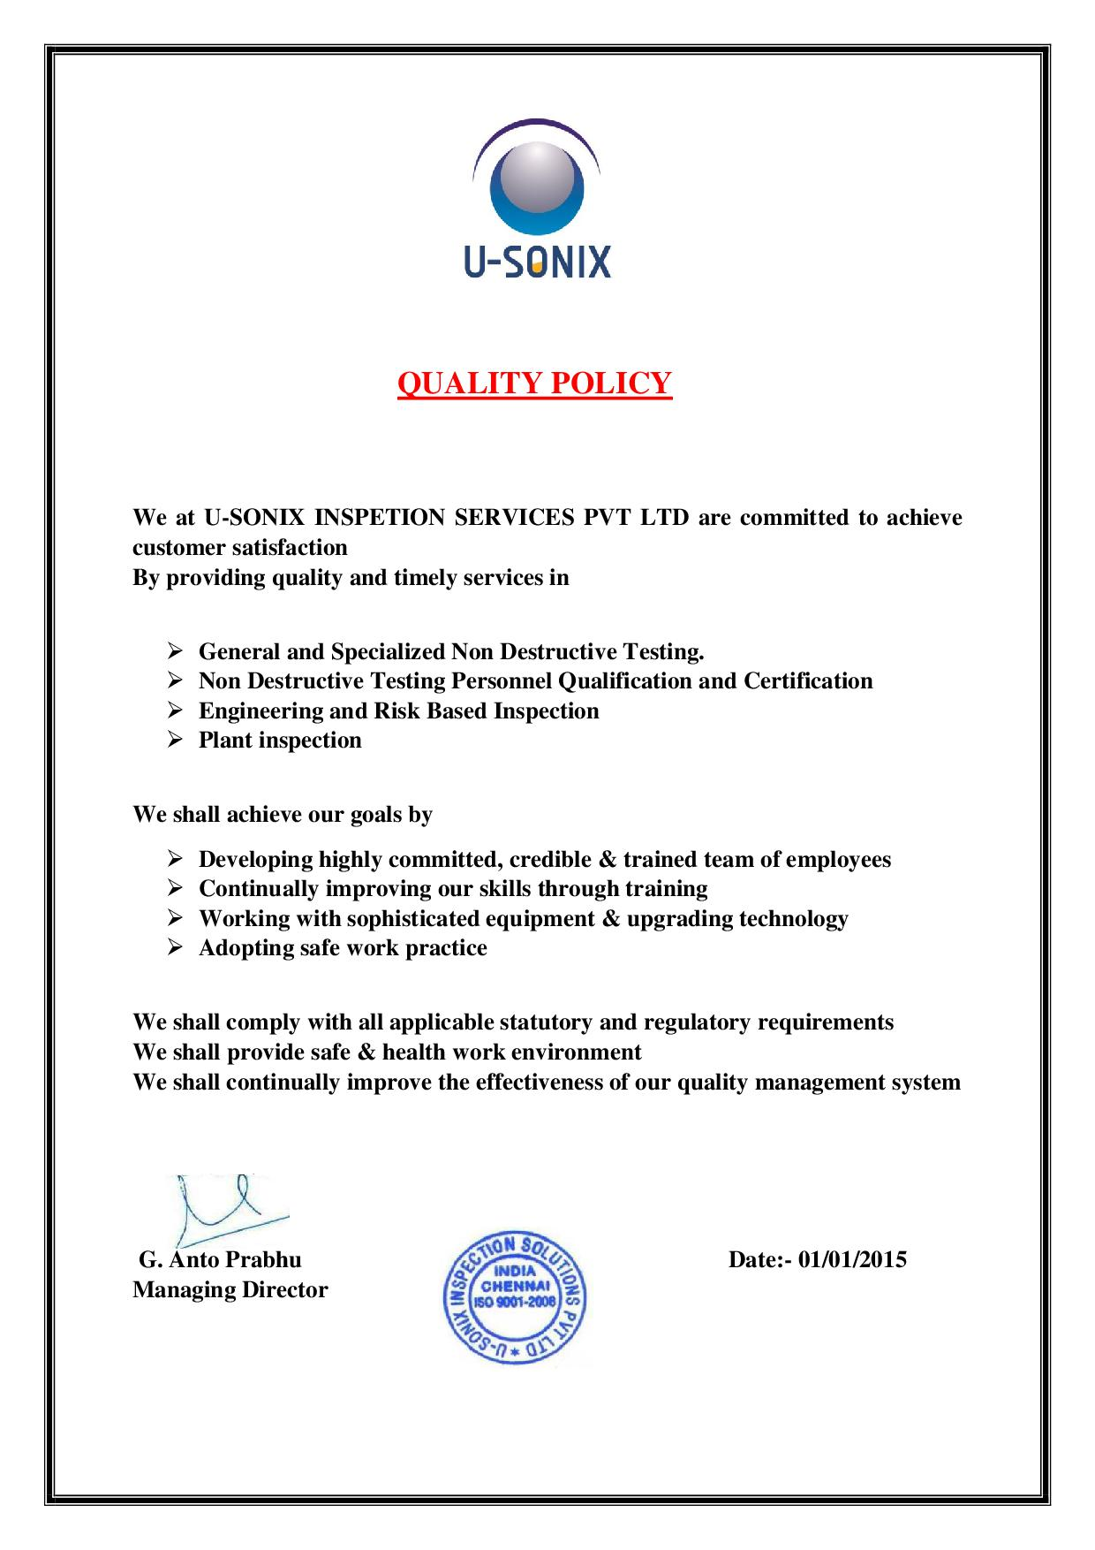
QUALITY POLICY

Slide 21
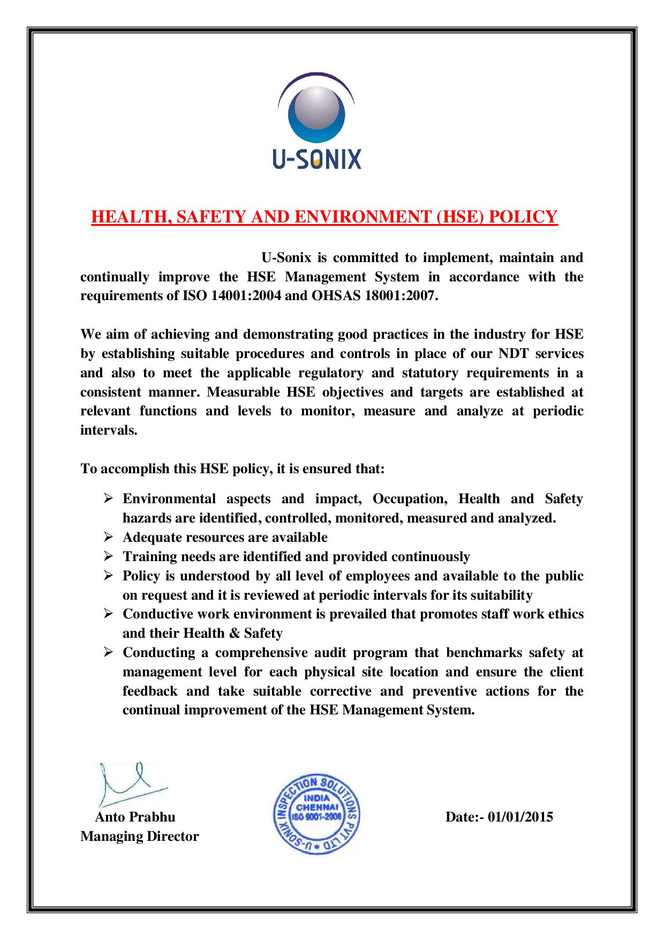
HSE POLICY

Slide 22
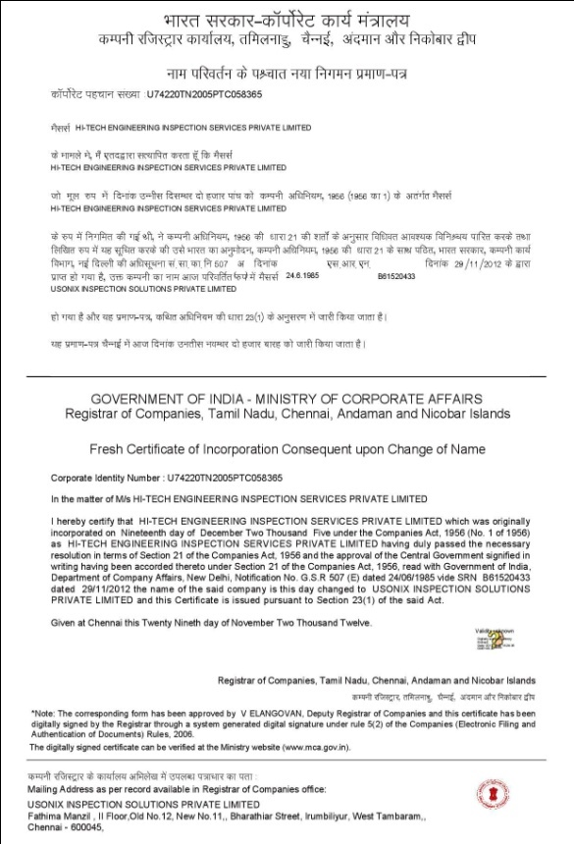
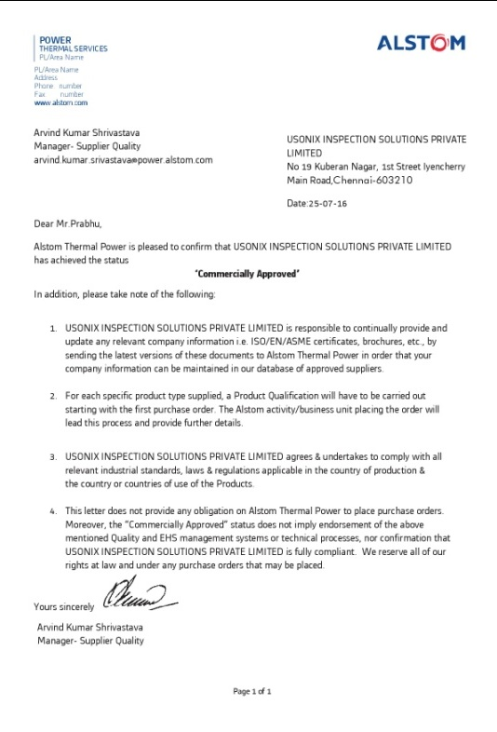
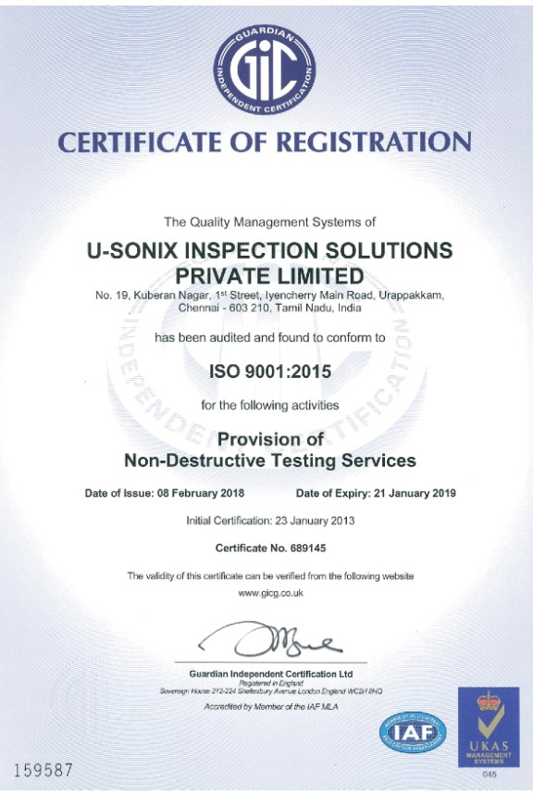
CERTIFICATIONS & ACCREDITATIONS
Company Registration copy
Approved Vendor for Alstom/GE
ISO 9001:2015 Certificate

Slide 23
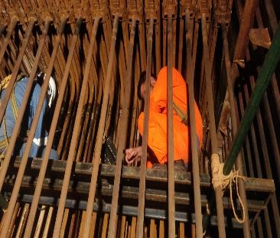
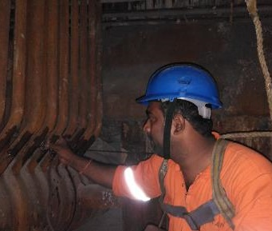
SOME PAST PROJECT PHOTOS
PAUT Inspection of Boiler Tubes for GE(Power) at MPL ,Jharkhand

Slide 24
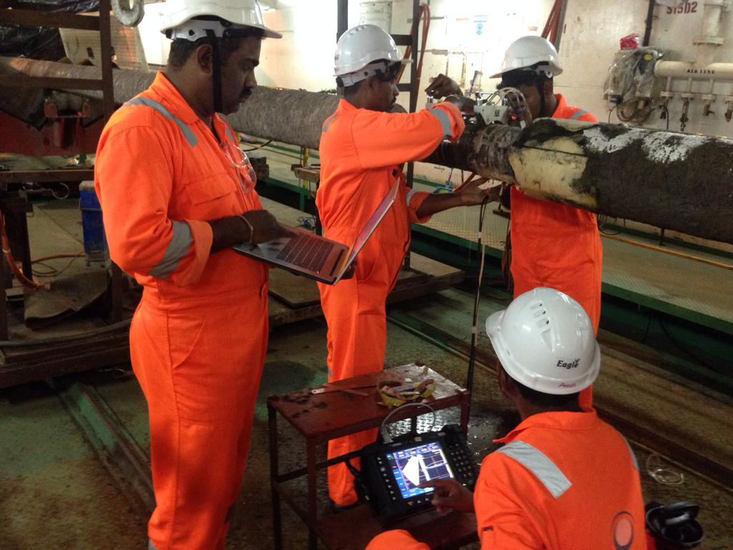
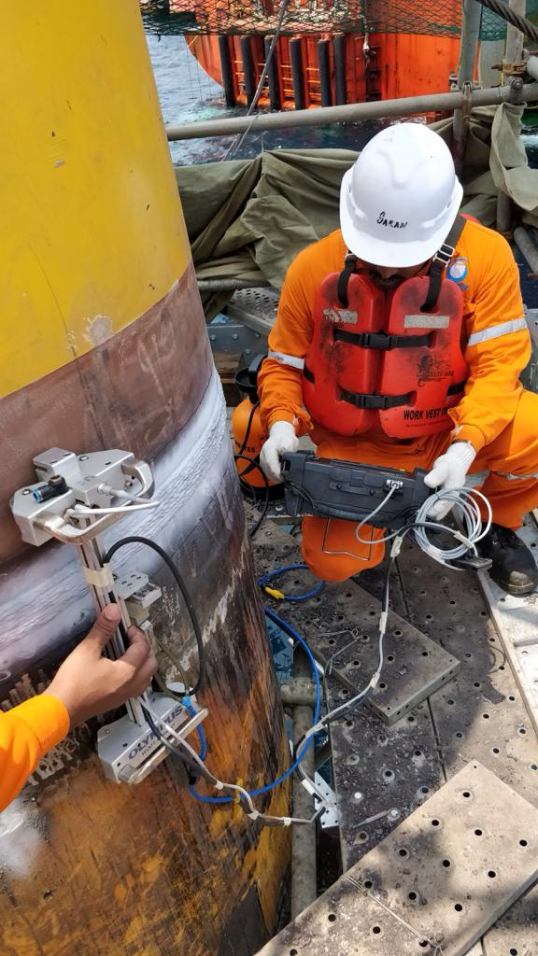
SOME PAST PROJECT PHOTOS

Slide 25
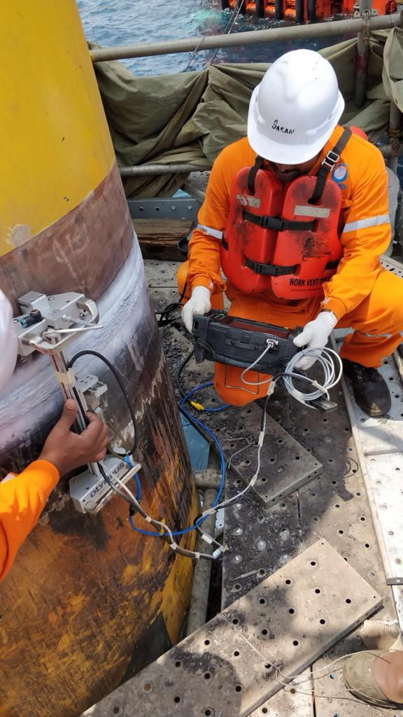
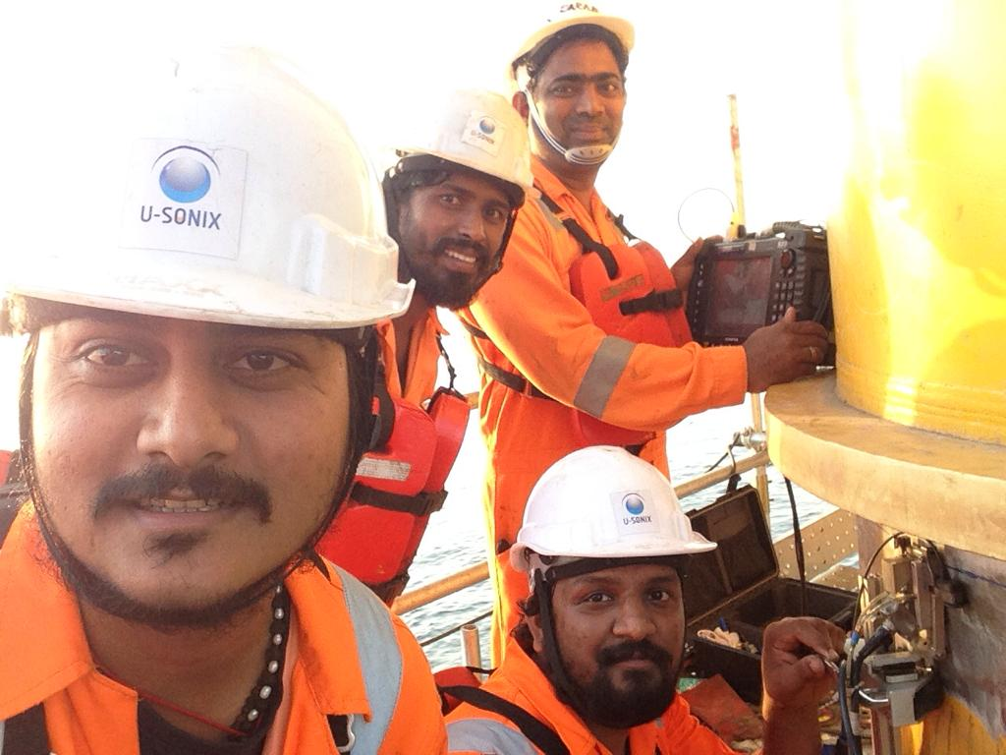
SOME PAST PROJECT PHOTOS

Slide 26
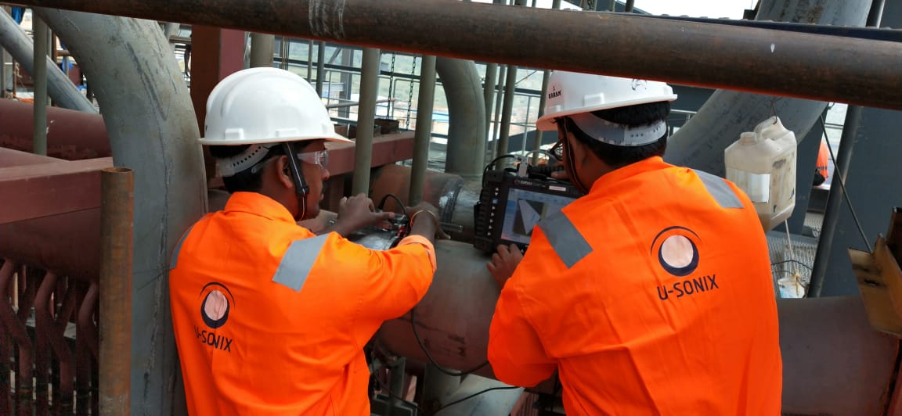
SOME PAST PROJECT PHOTOS

Slide 27
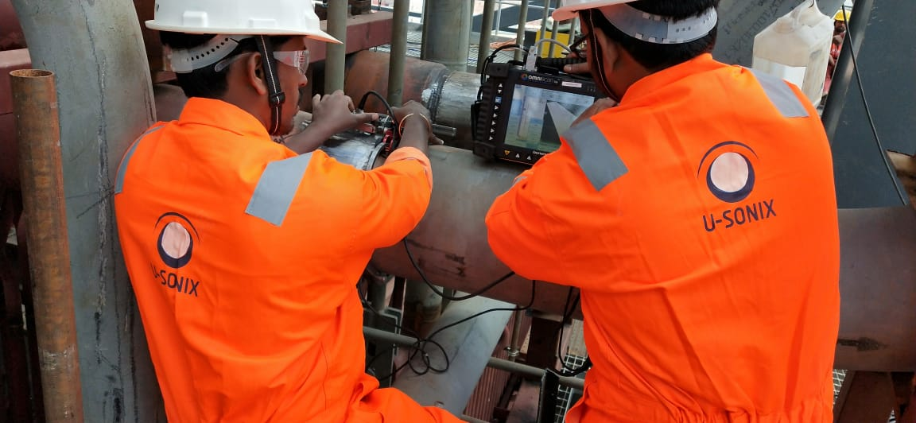
SOME PAST PROJECT PHOTOS

Slide 28
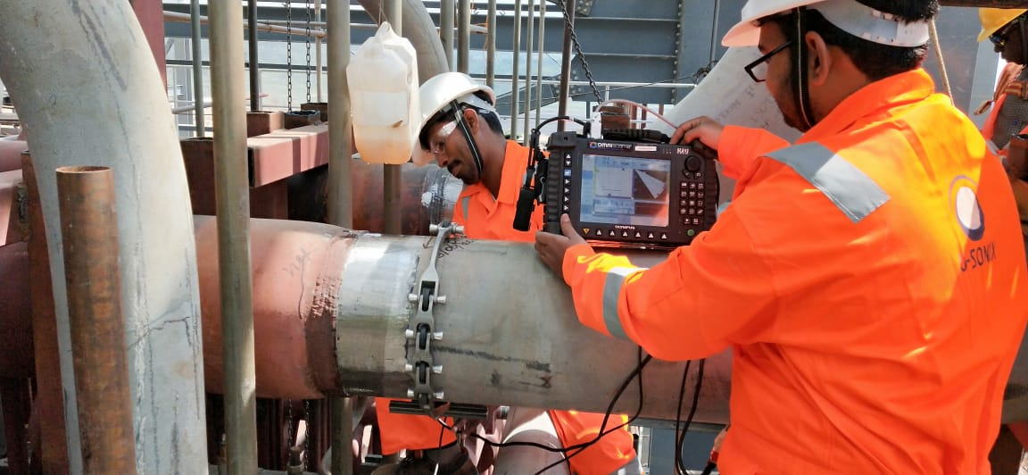
SOME PAST PROJECT PHOTOS

Slide 29
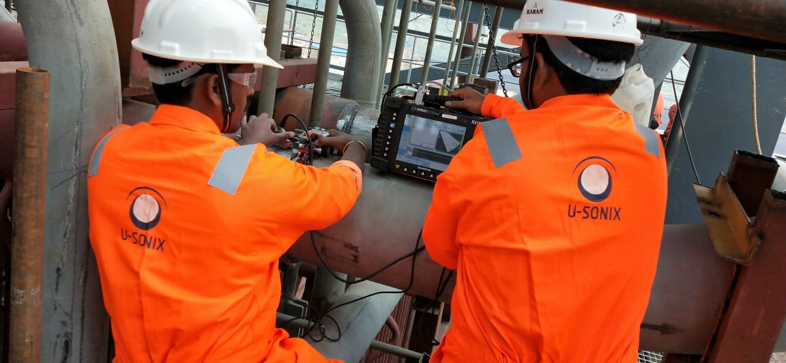
SOME PAST PROJECT PHOTOS

Slide 30
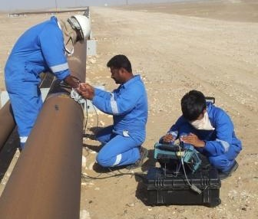
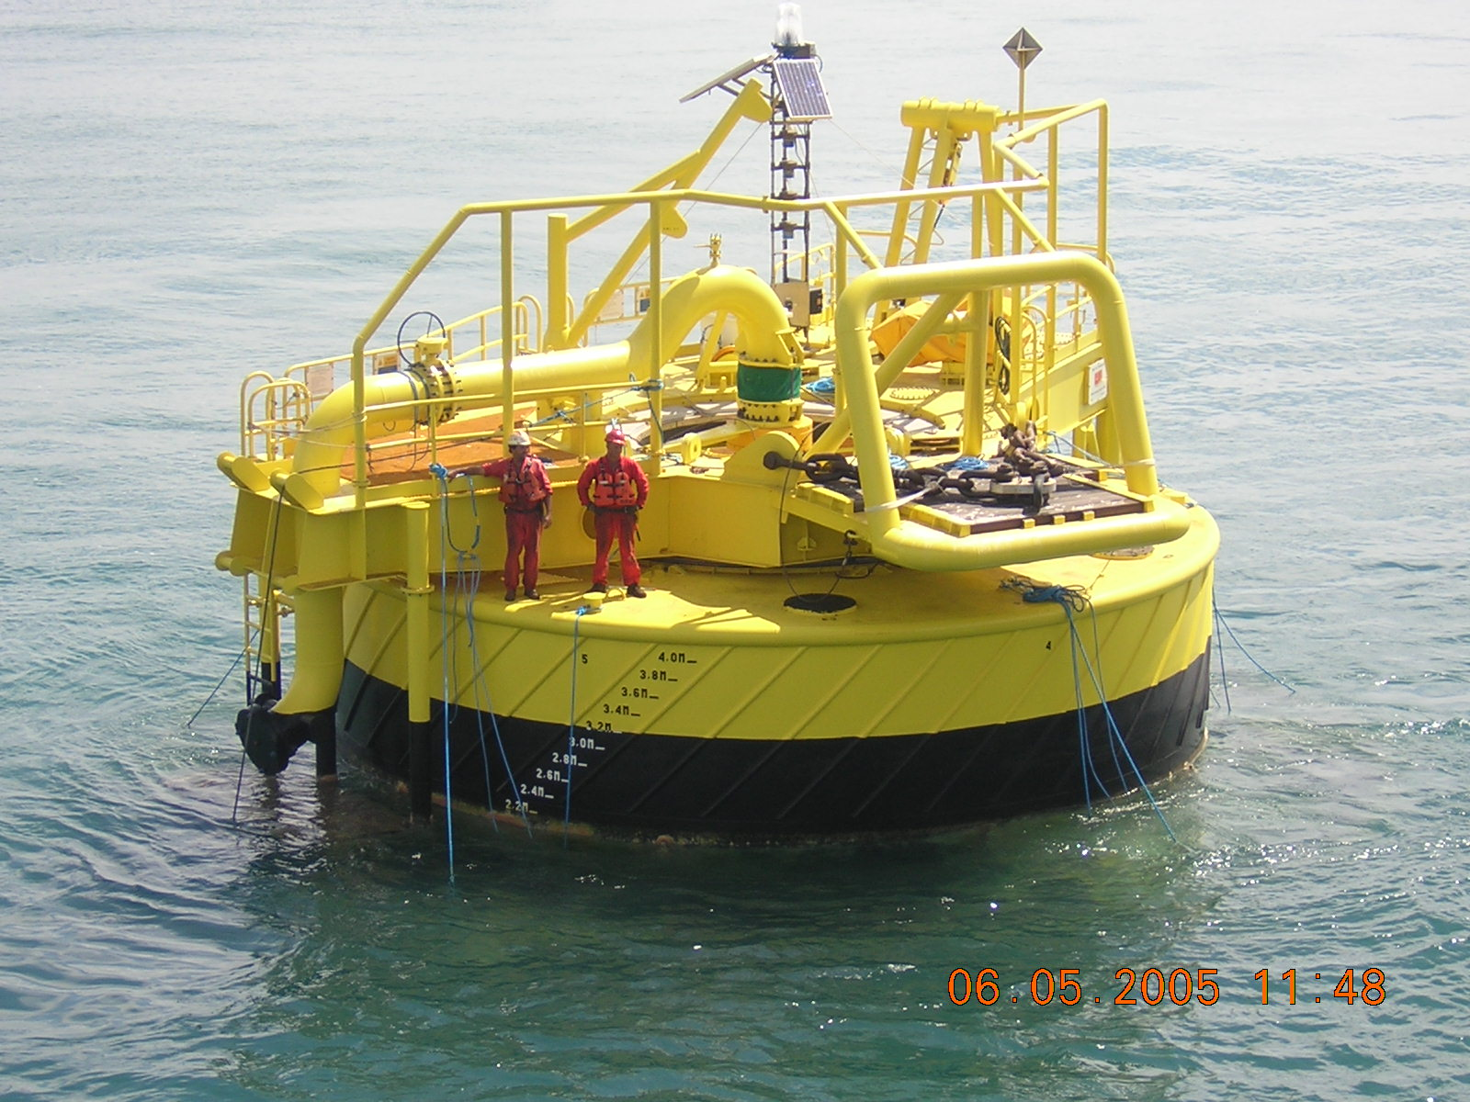
SOME PAST PROJECT PHOTOS
PAUT Inspection Of Pipelines for PDO Oman
SBM Installation Inspection - Ghana

Slide 31
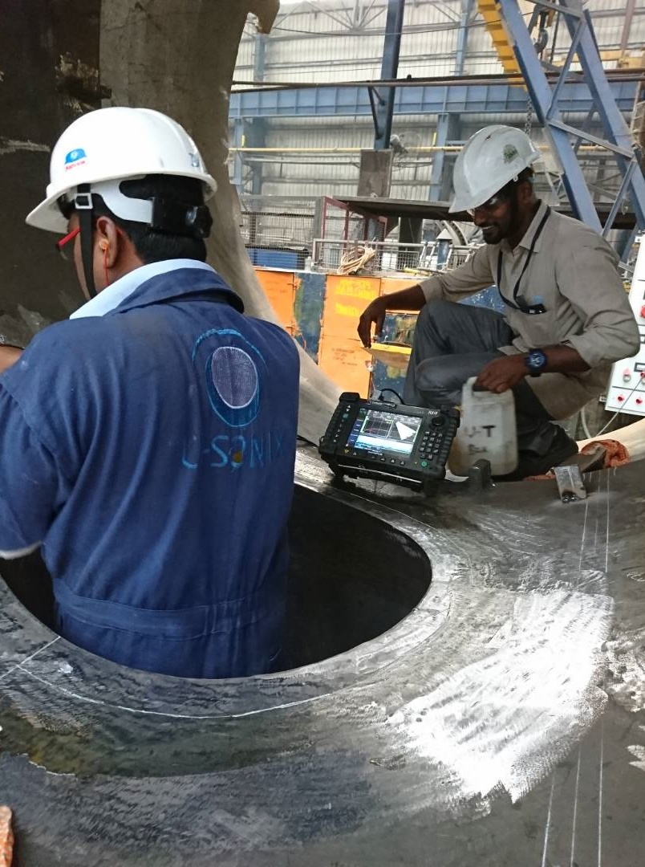
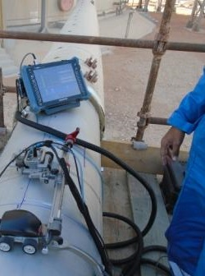
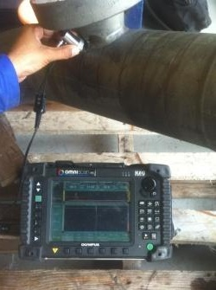
SOME PAST PROJECT PHOTOS
PAUT Inspection of Shell Nozzle at ISGEC Yamuna Nagar
Hydroform Corrosion
Mapping - Velosi Oman
PAUT Inspection of Spool at Aker Solutions, India

Slide 32
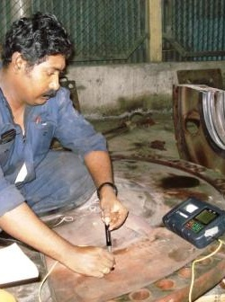
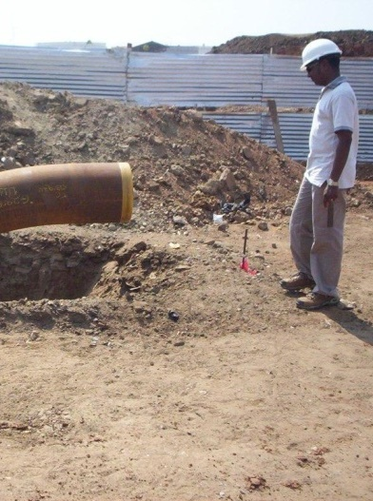
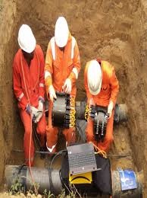
SOME PAST PROJECT PHOTOS
Petro Rabigh - Saudi Arabia
Project Support Services- Ghana
LRUT (Guided Wave) & Hydroform Corrosion Mapping - Shell, Nigeria

Slide 33
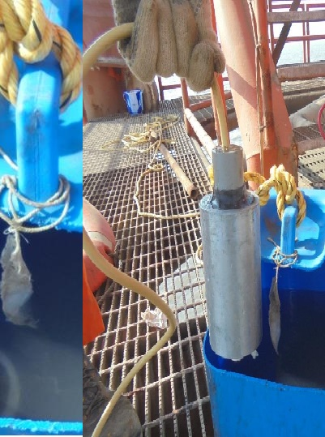
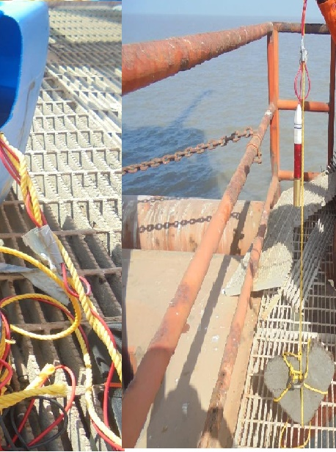
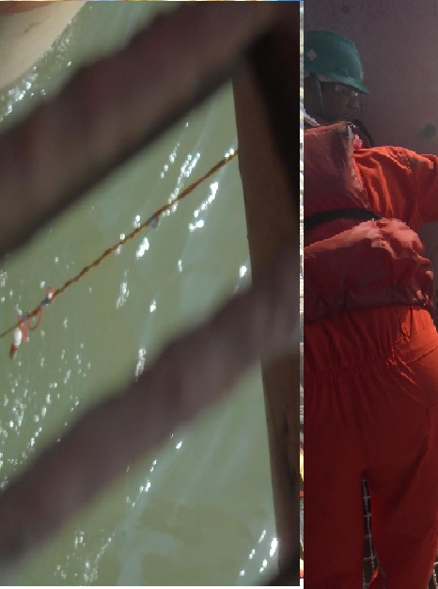
SOME PAST PROJECT PHOTOS
Shell India – CP Survey of Offshore Platforms

Slide 34
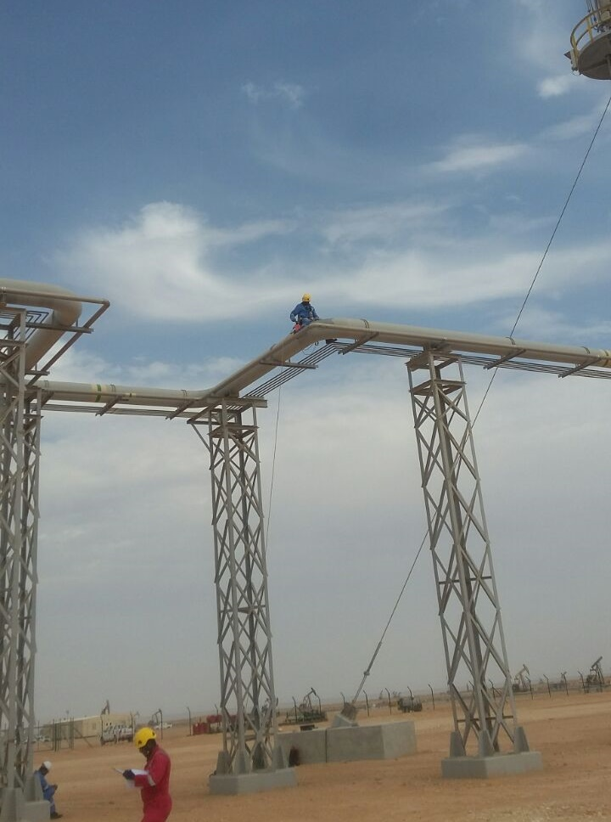
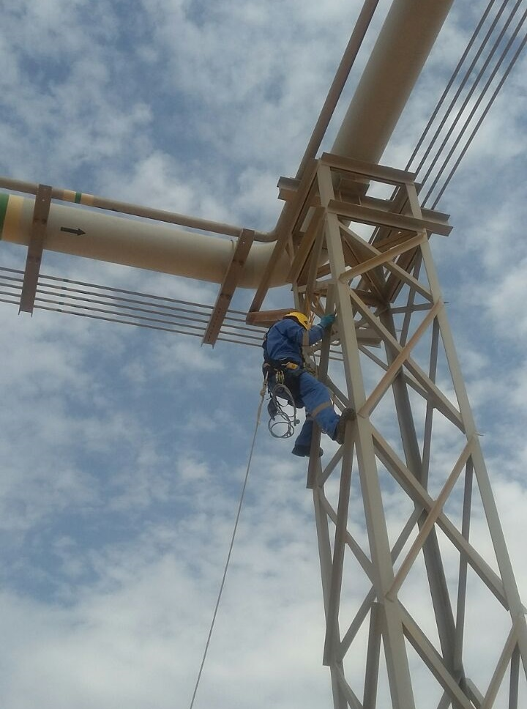
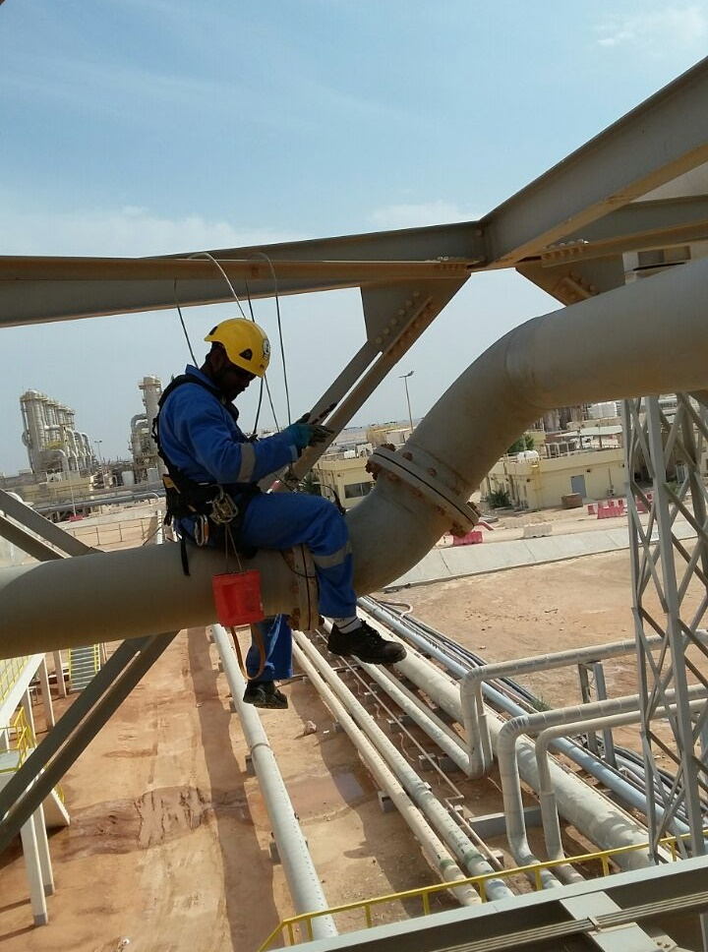
SOME PAST PROJECT PHOTOS
Rope Access NDT Services, OMAN

Slide 35
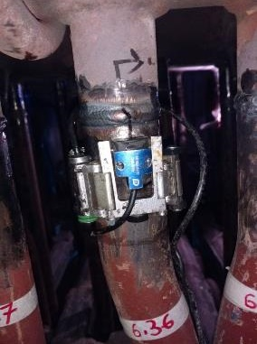
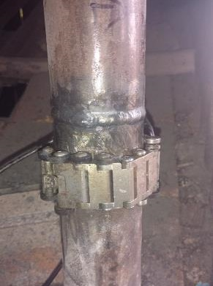
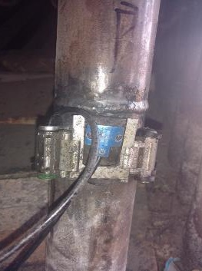
SOME PAST PROJECT PHOTOS
PAUT of Power Plant Piping Using Cobra Scanner at Sonichar,NIGER

Slide 36
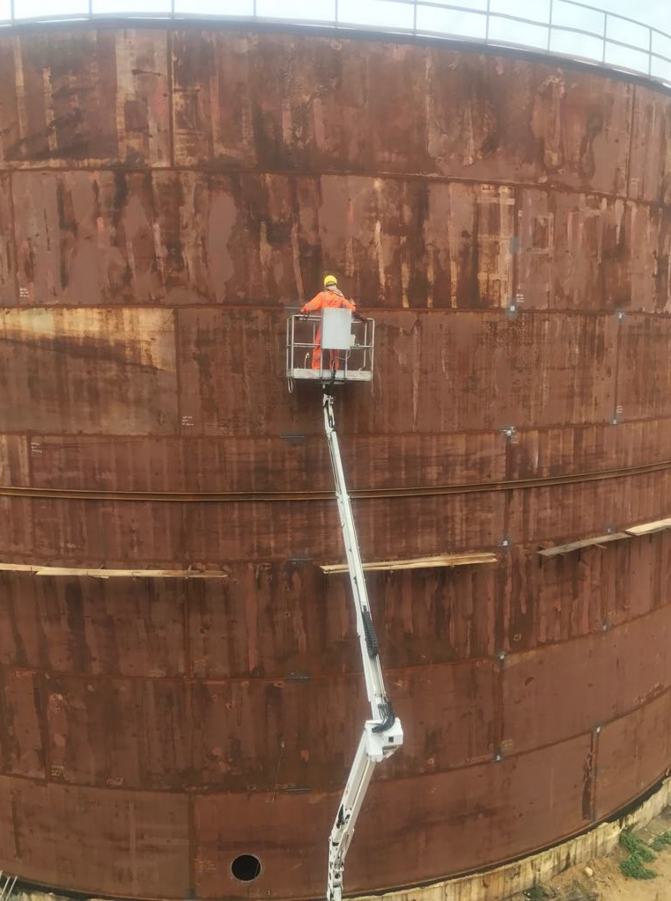
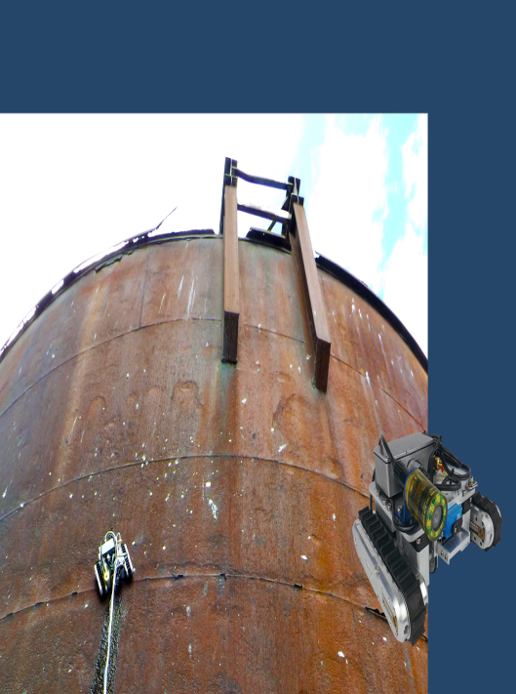
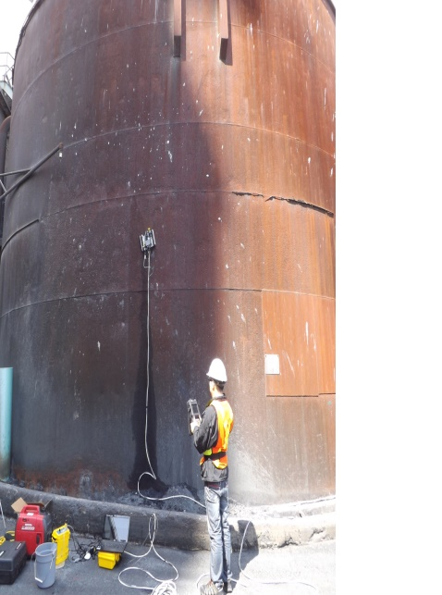
SOME PAST PROJECT PHOTOS
PAUT of Storage Tank, Nigeria

Slide 37
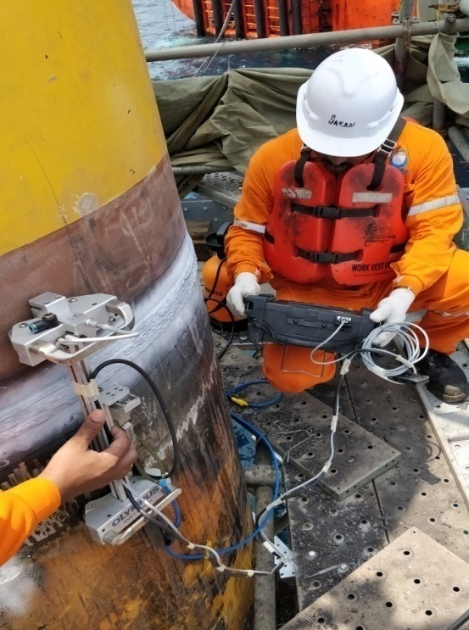
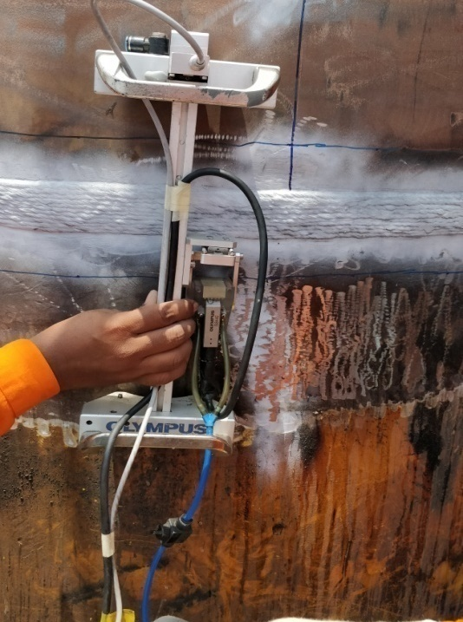
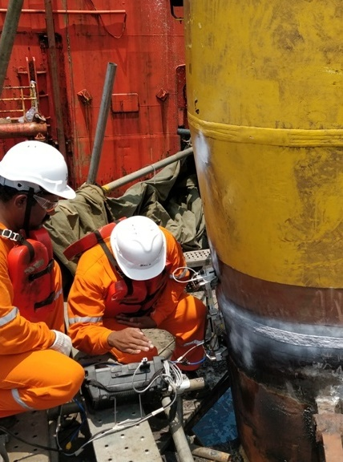
SOME PAST PROJECT PHOTOS
PAUT Inspection at Offshore Platform ONGC/LTHE, India

Slide 38
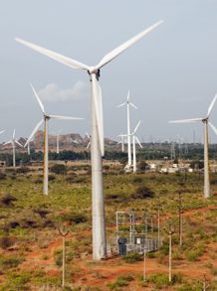
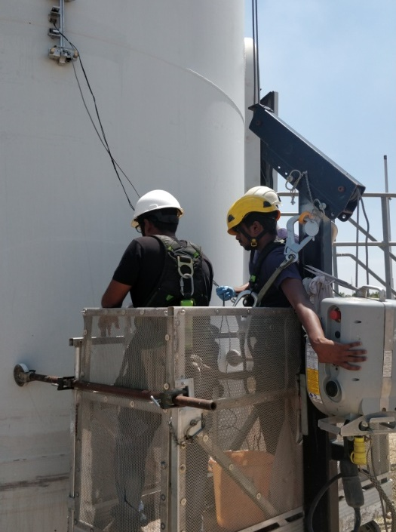
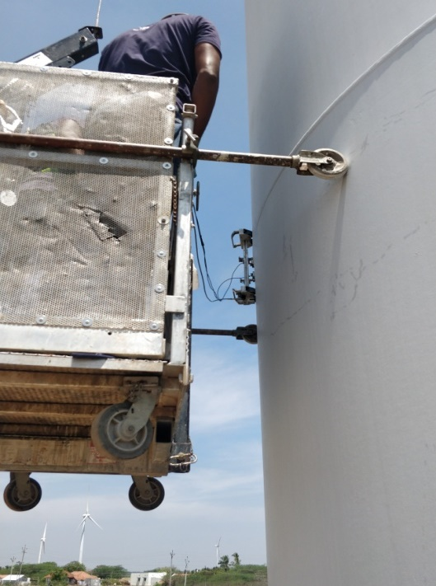
SOME PAST PROJECT PHOTOS
PAUT & TOFD Inspection Vestas Wind Farm, India

Slide 39
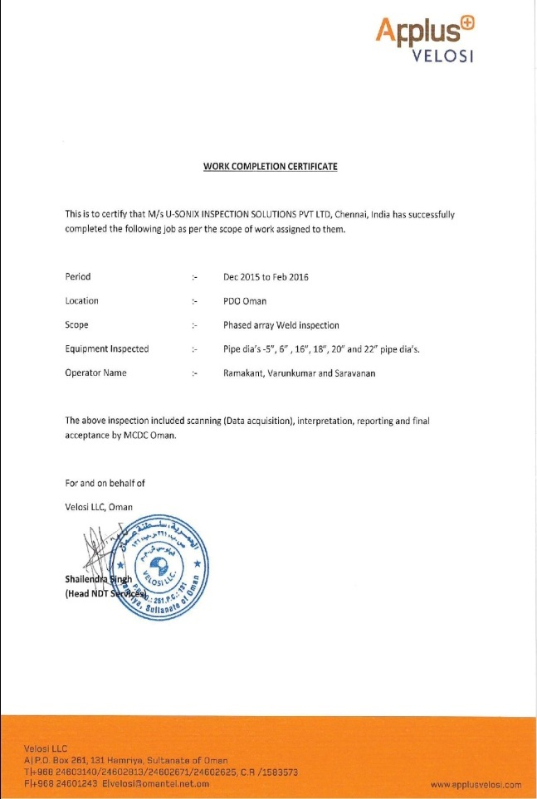
SAMPLE WORK COMPLETION CERTIFICATE
ASLTOM/GE, India
APPLUS VELOSI, Oman
SHELL/DYNAQUEST, Nigeria

Slide 40
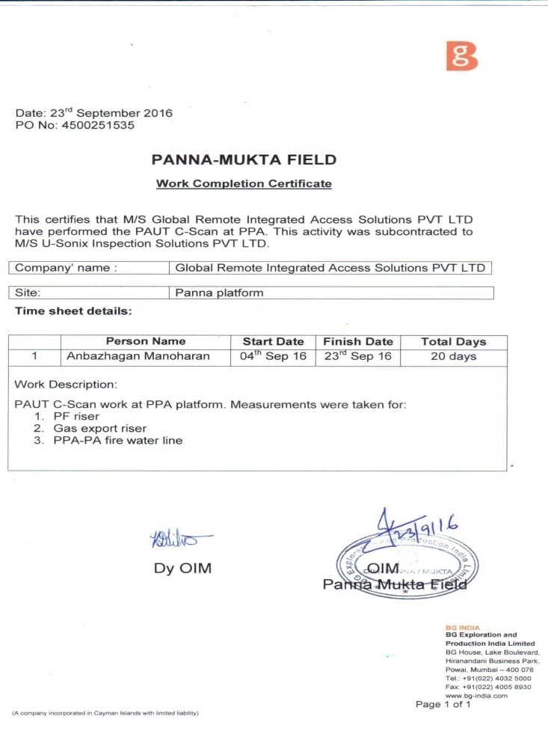
SAMPLE WORK COMPLETION CERTIFICATE
BRITISH GAS , India
APPLUS VELOSI, Qatar

Slide 41












SOME OF OUR MAJOR CLIENTS

Slide 42








SOME OF OUR MAJOR CLIENTS

Slide 43




OUR PARTNERS
OTI Malaysia
Oman
Morocco
Nigeria

Slide 44

OUR ASSOCIATES
Nigeria
UAE and Mumbai

Slide 45



CONTACT DETAILS
Head office
Branch office
U-Sonix Inspection Solutions Pvt Ltd,
U-Sonix International FZ-LLC,
U-sonix Inspection solution Pvt Ltd
2A/2 Annai complex, Rajendra Nagar
Club Road, East Tambaram.
Behind Sankara Vidhyalaya School
Chennai – 600059
+91 98407 86687, 6383992501
admin@u-sonix.com
www.u-sonix.com
T1-9F-1C, AC01,
Al Hamara Industrial Zone-FZ ,
Ras al-Khaimah,
United Arab Emirates.
+91 98407 86687 , 6383992501
Operations@u-sonix.com
www.u-sonix.com

